Slide 1

Strings and RegExp
String Operations and Regular Expressions
SoftUni Team
Technical Trainers
Software University
http://softuni.bg

Slide 2
Table of Content
Strings
Definition
Comparing strings
Methods
RegExp
Definition
Patterns
Methods

Slide 3
Have a Question?
sli.do
#JS-CORE

Slide 4

Strings in JavaScript
String Operations and Methods

Slide 5
What is a String?
JavaScript strings are used for storing and manipulating text
You can use the + operator to append multiple strings together:
let str = "Hello, World!";
let longString = "This is a very long string" +
"to wrap across multiple lines" +
"otherwise my code is unreadable."

Slide 6
Quotes in Strings
Unlike some other languages, JavaScript makes no distinction between single-quoted strings and double-quoted strings.
Quotes can be used inside a string, as long as they don’t match the quotes surrounding the strings:
let carName = "Volvo XC60"; // Double quotes
let carName = 'Volvo XC60'; // Single quotes
let str1 = "It's alright";
let str2 = "He is called 'Johnny'";
let str3 = 'He is called "Johnny"';

Slide 7
Length and Special Characters
The length of a string is found in the built in property length:
Special chars can be encoded using escape notation:
let myStr = "Find my length.";
let length = myStr.length; // 15
Code | Result | Description
\' | ' | Single quote
\" | " | Double quote
\\ | \ | Backslash

Slide 8
Escape Sequences
Code | Result
\b | Backspace
\f | Form Feed
\n | New Line
\r | Carriage Return
\t | Horizontal Tabulator
\v | Vertical Tabulator
let example = "This is an example \nfor a new line.";
// This is an example
// for a new line.

Slide 9
Comparing Strings
Equality - "==" - True if operands are the same, otherwise false.
Strict Equality - "===" - True if operands and data type are the same, otherwise false.
let sVal = "example";
if (sVal == "example") // true
let sVal = "example";
let sVal2 = new String("example");
if (sVal === sVal2) // not true

Slide 10
Comparing Strings
Inequality - "!=" - True if operands are not the same, otherwise false
Strict Inequality - "!==“ - True if operands and data type are not the same, otherwise false
let firstStr = "9900";
let firstNum = 9900
if (firstStr != secondStr) // false
let firstStr = "9900";
let firstNum = 9900
if (firstStr !== secondStr) // true

Slide 11
Comparing Strings (2)
Greater than - ">" (Greater than or equal - ">=")
True if first operand is greater than (or equal) to the second one.
Less than - "<" (Less than or equal - "<=")
True if second operand is greater than (or equal) to the first one.
if ("b" > "a") // true
if ('Example of a long string' <= 'A short one') // false

Slide 12

String Methods
indexOf() - returns the position of the first found occurrence of a specified value in a string
lastIndexOf() - returns the position of the last found occurrence of a specified value in a string
search() - searches a string for a specified value

Slide 13
String Methods (2)
slice() - extracts a part of a string and returns a new one.
substring() - extracts the characters from a string between two specified indices.
substr() - extracts the characters from a string, beginning at a specified start position and through the specified length.

Slide 14
String Methods: Examples
let str = "JavaScript is fun!";
console.log(str.indexOf("JavaScript")); // 0
console.log(str.indexOf("java")); // -1
let str = "I am JavaScript developer";
let sub = str.substr(5); // substr(start, length)
console.log(sub); // JavaScript developer
let str = "I am JavaScript developer";
let sub = str.substring(5, 9); // startIndex, endIndex
console.log(sub); // Java

Slide 15
String Methods: Examples
Accessing elements like an Array
Converting string to an array with the split method
let str = "JavaScript is fun!";
let letter = str[0];
console.log(letter); // J
let str = "JavaScript is fun!";
let letter = str.charAt(0);
console.log(letter); // J
let str = "I like JS";
let tokens = str.split(' ');
console.log(tokens); // ["I", "like", "", "", "", "JS"]
tokens = tokens.filter(s => s!='');
console.log(tokens.join(' ')); // I like JS

Slide 16
Problem: Pascal or Camel Case
Convert the first string to either "Pascal Case" or "Camel Case".
function solve() {
let input = document.getElementById("str1").value;
let currentCase = document.getElementById("str2").value;
function pascalOrCamelCase(input, currentCase) {
let split = input.toLowerCase().split(' ').filter(a => a !== '');
let output = "";
if (currentCase === "Pascal Case") {
for (let word of split) {
if (word[0] !== word[0].toUpperCase()) {
word = word.replace(word[0], word[0].toUpperCase())
}
output += word;
}
}
// Continues on the next slide

Slide 17
Problem: Pascal or Camel Case
else if (currentCase === "Camel Case") {
for (let word of split) {
if (word[0] !== word[0].toUpperCase()) {
word = word.replace(word[0], word[0].toUpperCase())
}
output += word;
}
output = output.replace(output[0], output[0].toLowerCase());
} else {
output = "Error!";
}
document.getElementById("result").innerHTML = output;
}
pascalOrCamelCase(input, currentCase);
}
Check your solution here: https://judge.softuni.bg/Contests/Practice/Index/1476#0

Slide 18
Problem: Find ASCII Equivalent
If the current element of the string is of type number, print its ASCII char equivalent. Else, print the corresponding ASCII number.
function solve() {
let input = document.getElementById("str").value;
let result = document.getElementById('result');
function findAsciiEquivalent(input) {
let split = input.split(' ').filter(a => a !== '');
let output = "";
for (let element of split) {
if (Number(element)) {
output += (String.fromCharCode(element));
}
// Continues on the next slide
Check your solution here: https://judge.softuni.bg/Contests/Practice/Index/1476#1

Slide 19
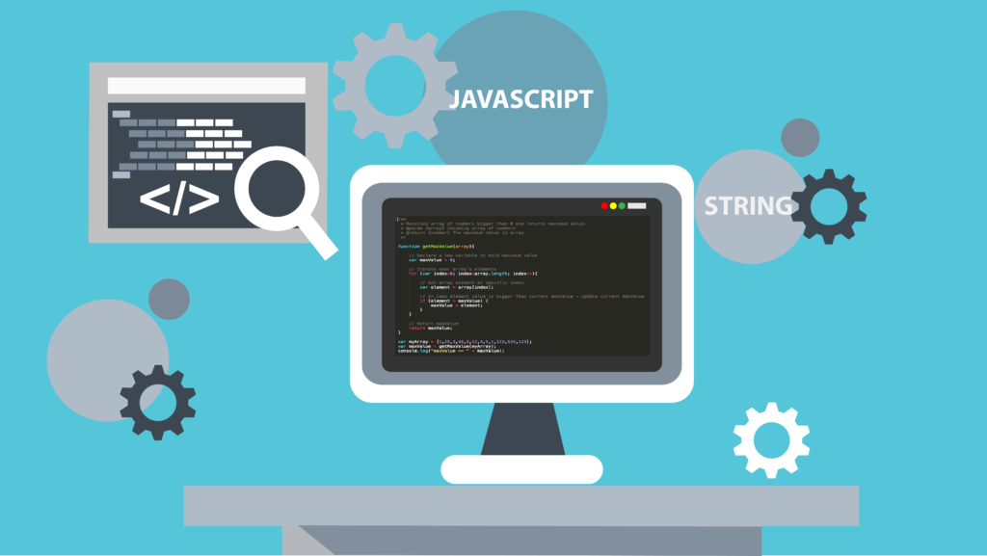
Problem: Find ASCII Equivalent
else {
let charToNum = [];
for (let i = 0; i < element.length; i++) {
charToNum.push(element[i].charCodeAt(0))
}
let p = document.createElement('p');
p.innerHTML = charToNum.join(' ')
result.appendChild(p);
}
}
let p = document.createElement('p');
p.innerHTML = output;
result.appendChild(p);
}
findAsciiEquivalent(input);
}

Slide 20
Problem: Split String Equally
You will receive a string and a positive integer (bigger than 0!). Split the string into equal sequences by the number you received.
function solve() {
let string = document.getElementById("str").value;
let n = parseInt(document.getElementById("num").value);
function splitStringEqually(string, n) {
let arr = [];
let indexCounter = 0;
if (string.length % n !== 0) {
let len = string.length;
let symbolsCount = 0;
// Continues on the next slide
Check your solution here: https://judge.softuni.bg/Contests/Practice/Index/1476#2

Slide 21

Problem: Split String Equally
while (len % n !== 0) {
len %= n;
len++;
symbolsCount++;
}
for (let i = 0; i < symbolsCount; i++) {
string += string[indexCounter];
indexCounter++;
}
}
for (let i = 0; i < string.length; i += n) {
arr.push(string.substr(i, n));
}
document.getElementById("result").innerHTML = arr.join(' ');
}
splitStringEqually(string, n);
}

Slide 22
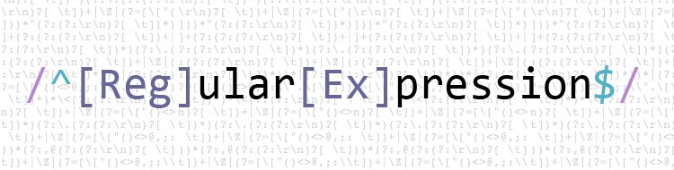
Regular Expressions
The Beauty of Modern String Processing

Slide 23
What are Regular Expressions?
Match text by pattern
RegExp in string methods
/i -> makes the regex match case insensitive
let str = "RegExp Example";
let search = str.search(/RegExp/i) // 0
/g -> replaces all matches
let str = "Java Regex Example Java";
let search = str.replace(/Java/g, "JavaScript");
// JavaScript RegExp Example JavaScript

Slide 24
Problem: Replace a Certain Word
For each string in the array, replace the necessary word with the given one.
function solve() {
let arr = JSON.parse(document.getElementById("arr").value);
let word = document.getElementById("str").value;
let result = document.getElementById('result');
function replaceCertainWord(arr, word) {
let wordToReplace = arr[0].split(' ').filter(a => a !== '')[2];
let regex = new RegExp(wordToReplace, 'gi');
for (let sentence of arr) {
sentence = sentence.replace(regex, word);
let p = document.createElement('p');
p.innerHTML = sentence
result.appendChild(p);
}
}
replaceCertainWord(arr, word);
}
Check your solution here: https://judge.softuni.bg/Contests/Practice/Index/1476#3

Slide 25
Patterns
Patterns are defined by special syntax, e.g.
[0-9]+ matches non-empty sequence of digits
[A-Z][a-z]* matches a capital + small letters
\s+ matches whitespace (non-empty)
\S+ matches non-whitespace
[0-9]{3,6} – matches 3-6 digits
\d+ matches digits
\D+ matches non-digits
\w+ matches non-letters
\W+ matches non-letters

Slide 26
RegEx Brackets
[abc] | Find any character between the brackets
[^abc] | Find any character NOT between the brackets
[0-9] | Find any character between the brackets (any digit)
[^0-9] | Find any character NOT between the brackets (any non-digit)
(x|y) | Find any of the alternatives specified

Slide 27
Quantifiers
n+ - matches any string that contains at least one n
n* - matches any string that contains zero or more occurrences of n
n? - matches any string that contains zero or one occurrences of n
n{X} - matches any string that contains a sequence of X n’s
n{X,Y} - matches any string that contains a sequence of X to Y n’s
n{X,} - matches any string that contains a sequence of at least X n’s
n$ - matches any string with n at the end of it
^n – matches any string with n at the beginning of it

Slide 28
RegEx Methods
exec()
test() – returns true or false
let namePattern = (/[A-Z][a-z]+/g);
let names = "Test Testov, example, Example";
let match;
while(match = namePattern.exec(names)) { // Test
console.log(match[0]); // Testov
} // Example
let pattern = (/[0-9]+/g);
let str = "Test Testov";
console.log(pattern.test(str)); // false

Slide 29
Problem: Extract User Data
You have to extract all valid user data from each string
function extractUserData() {
let arr = JSON.parse(document.getElementById("arr").value);
let result = document.getElementById('result');
function userData(arr) {
let pattern =
/^([A-Z][a-z]* [A-Z][a-z]*) (\+359 [0-9] [0-9]{3} [0-9]{3}|\+359-[0-9]-[0-9]{3}-[0-9]{3}) ([a-z0-9]+@[a-z]+\.[a-z]{2,3})$/;
let match;
for (let data of arr) {
match = pattern.exec(data);
if (match) {
let firstParagraph = document.createElement('p');
firstParagraph.textContent = `Name: ${match[1]}`;
result.appendChild(firstParagraph); // Continues on the next slide
Check your solution here: https://judge.softuni.bg/Contests/Practice/Index/1476#4

Slide 30

Problem: Extract User Data
let secondParagraph = document.createElement('p');
secondParagraph.textContent = `Phone Number: ${match[2]}`;
result.appendChild(secondParagraph);
let thirdParagraph = document.createElement('p');
thirdParagraph.textContent = `Email: ${match[3]}`;
result.appendChild(thirdParagraph);
} else {
let errorParagraph = document.createElement('p');
errorParagraph.textContent = 'Invalid data';
result.appendChild(errorParagraph);
}
let dashes = document.createElement('p');
dashes.textContent = '- - -';
result.appendChild(dashes);
}
}
userData(arr);
}

Slide 31
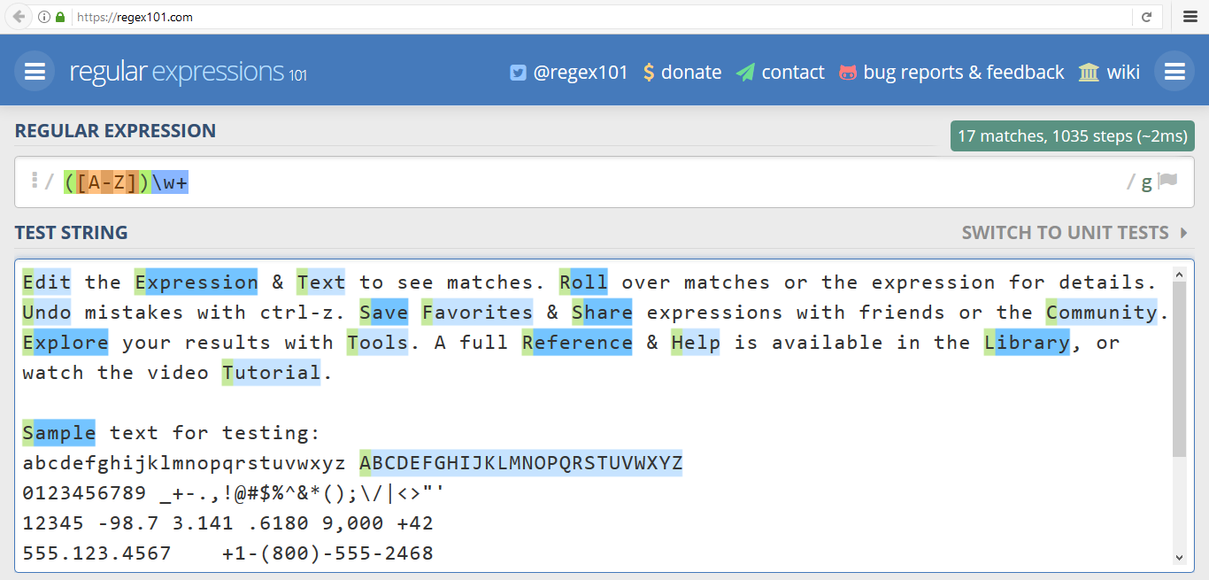
Live Demo
www.regex101.com

Slide 32

Live Exercises

Slide 33

Summary
…
…
…
Strings in JavaScript
String Methods: split(), substring(), indexOf(), trim(), replace() . . .
Regular expressions match text by pattern
Regex methods and quantifiers

Slide 34
https://softuni.bg/courses/javascript-fundamentals

Slide 35













SoftUni Diamond Partners

Slide 36




SoftUni Organizational Partners

Slide 37




Trainings @ Software University (SoftUni)
Software University – High-Quality Education and Employment Opportunities
softuni.bg
Software University Foundation
http://softuni.foundation/
Software University @ Facebook
facebook.com/SoftwareUniversity
Software University Forums
forum.softuni.bg

Slide 38

License
This course (slides, examples, demos, videos, homework, etc.) is licensed under the "Creative Commons Attribution-NonCommercial-ShareAlike 4.0 International" license

